Slide 1
Java: Constants, Variables and data types

Slide 2
Agenda of the Discussion
Introduction
Constants
Variables
Data types
Declaration of Variables
Giving values to Variables
Scope of Variables
Symbolic Constants
Standard Default Values

Slide 3
Basic Building units
Constants
Variables
Data Types

Slide 4
Constants
Constants in java refer to fixed values that do not change during the execution of program
Java supports to several types of constants

Slide 5
Constants
Java Constants
Numeric Constants
Character Constants
Integer Constants
Real Constants
Character Constants
String Constants

Slide 6
Constants
Integer Constants:- Sequence of digit
Decimal – 123, -987, 654321
Octal – 037, 0435, 0551
Hexadecimal – 0x2, 0xbf, 0xff
Real Constants
Real or floating point – 0.009, -45.88, - . 943
exponential – 0.65e4
Character Constants
‘5’ ‘x’ ’;’ ‘ ‘
String Constants
“Hello Java” “1987” “:)” “#$%”

Slide 7
Constants
Backslash Character Constants(Escape sequence)
Constant | Meaning
‘\b’ | backspace
‘\f’ | Form feed
‘\n’ | New line
‘\r’ | Carriage return
‘\t’ | Horizontal tab
‘ \’ ’ | Single quote
‘ \” ’ | Double quote
‘ \ \ ’ | Backslash

Slide 8
Variables
Variable:
Identifier, Denotes a storage location used to store a data value
Unlike constants, values of variable may change during execution of program
Programmer should be chosen in meaningful way so as to reflect what it represents in the program. E.g. average, total_height, Class_Strength, etc.
Rules:
No white space
No keywords (Except $ and _)
Beginning with digit is not allowed
Any length

Slide 9
Data types
Java Data Types
Primitive
Non-Primitive
Numeric
Non Numeric
Classes
Interface
Arrays
Integer
Floating point
Character
Boolean

Slide 10
Data types
Integer
Byte
Short
Int
Long

Slide 11
Data types
Floating Point
Float
Double

Slide 12
Data types
Character Type

Slide 13
Data types
Boolean Type

Slide 14
Data types
Type | Size | Minimum Value | Maximum Value
Byte | 1 Byte | -128 | 127
Short | 2 Bytes | -32,768 | 32767
Int | 4 Bytes | -2,147,483,648 | 2,147,483,647
Long | 8 Byte | -9,223,372,036,854,775,808 | 9,223,372,036,854,775,807
Float | 4 Byte | 3.40282347 x 10³⁸ | 1.40239846 x 10⁻⁴⁵
double | 8 Byte | 1.7976931348623157 x 10³⁰⁸ | 4.9406564584124654 x 10⁻³²⁴
Char | 2 Byte
Boolean | 1 byte

Slide 15
Declaration of Variables
Variable:
are the names of storage locations.
Must be declared before it is used
Declaration does three things
It tells compiler what the variable name is.
It specifies what type of data the variable will hold
The place of declaration (in the program) decides the scope of variable

Slide 16
Giving values to Variables
By Using Assignment Statement
variable_name=value
a=10, name = ‘A’, result= 22.22;
x=y=z=0;
type Variable_name=value
int f1 =100, char yes= ‘x’
Giving initial value is called initialization,
Variables not initialized, are set to zero automatically

Slide 17
Standard Default Values
Type of variable | Default Value
Byte | 0
Short | 0
Int | 0
Long | 0
Float | 0.00f
Char | ‘\u0000’
Boolean | False

Slide 18
Scope of Variables
Instance variable
Class variable
Local variable

Slide 19
Scope of Variables
Instance variable
Declared inside the class
Created when objects are declared, associated with objects
Different values for different objects

Slide 20
Scope of Variables
Class variable (Static Variable)
Declared inside the class
Global to class
Belongs to entire set of objects
Only one memory location is created for each

Slide 21
Scope of Variables
Local variable
Declared inside the method
Not available for use of outside the method definition
Can also be declared inside blocks that are defined between an opening { and closing brace}.
These variables are visible to the program only from the beginning of its program block to the end of the program block.
The area of program where the variable is accessible is called its scope.
Program block within another program block is called nesting

Slide 22
Scope of Variables
{ int x=0;
Block 2
{….
…..
int m=10;
…}
}
Block 3
Block 1
{
int n=5;
}

Slide 23
Symbolic Constants
Requirement of certain unique constants in a program. e.g.
value of pie – 3.142
calculation of mean, std dev etc we require total
for this we may use symbolic names to such constants, e.g. PI, TOTAL, PASSING_MARKS etc.
A Constant is declared as
final int STRENGTH=100;
final int PASS_MARKS=50;
final float PI = 3.14159

Slide 24
JAVA Type Casting
Type casting is when you assign a value of one primitive data type to another type
Two types of Type casting
Widening Casting (Automatically) :- converting a smaller type to a larger data type
Byte->short->char->int->long->float->double
Narrowing Casting :- (Manually) :- converting larger type to small type of data type
double -> float -> long-> int->char->short -> byte

Slide 25
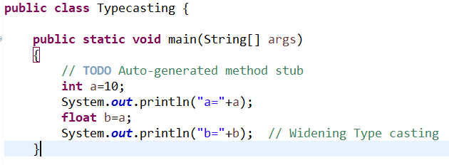
JAVA Widening Type Casting
From | To
Byte | Short, char, int , long, float, double
Short | char, int , long, float, double
Char | int , long, float, double
Int | long, float, double
Long | float, double
Float | double

Slide 26
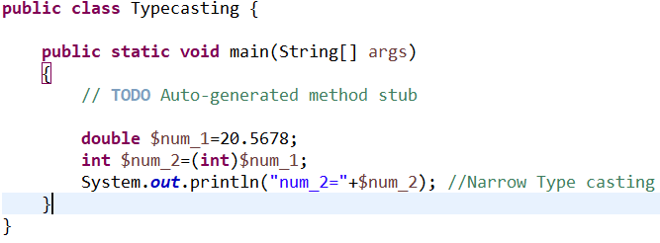
JAVA Narrowing Type Casting
Syntax:- data type variable1 =(data type) variable2

Slide 27
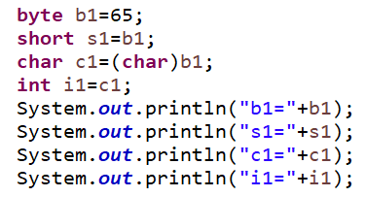

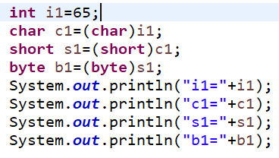

JAVA Narrowing Type Casting

